Slide 1
Equality and Diversity
Part of the DNA of Care Programme

Slide 2
Why does it matter?
"You never really understand a person until you consider things from his point of view - until you climb into his skin and walk around in it."
Atticus Finch Chapter 3 of To Kill a Mockingbird
‘’Empathy begins with understanding life from another person's perspective. Nobody has an objective experience of reality. It's all through our own individual prisms.’’
Sterling K. Brown
Notes:
Empathy begins with understanding life from another person's perspective. Nobody has an objective experience of reality. It's all through our own individual prisms. Sterling K. Brown – an American Actor Read more at: https://www.brainyquote.com/quotes/sterling_k_brown_775174?src=t_experience

Slide 3
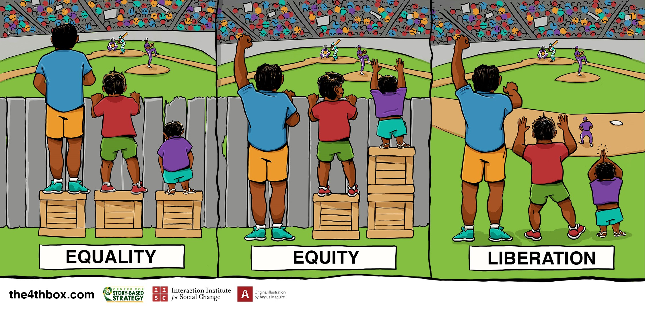

Slide 4
The DNA of Care
‘The intertwined relationship between patient care and staff well-being has been likened to the double helix. And so the stories we tell each other are like the DNA of care, transmitting information and shaping cultures, offering learning opportunities and, sometimes, healing.’
Pip Hardy and Tony Sumner, 2016

Slide 5
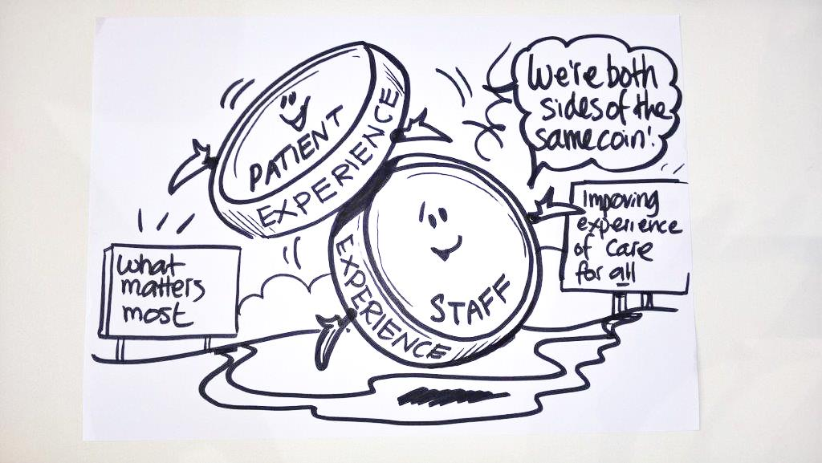
Two sides of the same coin
Staff experience drives patient experience.
‘Focusing on this relationship could be the most important move for the healthcare system to make.’
Karen Deeny, 2017

Slide 6
Background to WRES
Black and minority ethnic staff in the NHS have less favourable experiences and opportunities compared to white colleagues
This has significant impact upon staff as well as upon the care for all patients
Through behavioural and cultural change, the WRES programme supports healthcare organisations to understand their performance on workforce race equality, and supports them to continuously improve

Slide 7
Background to LDEP
LDEP: Research has shown that by offering employment to people with learning disabilities they live longer and more fulfilled lives
Long serving, enthusiastic and motivated employees
We need to make the most of the range of talents, expertise and experience of a workforce that also represent the people that we serve.
Photo © Pip Hardy

Slide 8
Background to WDES
2015 NHS England commissioned Middlesex and Bedfordshire Universities to research the Experiences of Staff with Disabilities in the NHS Workforce
Fewer staff with disabilities reported such on ESR than in the anonymous staff survey
Disabled staff less satisfied with the quality of their appraisal than non-disabled colleagues
Staff with disabilities rate themselves as more dissatisfied with the recognition, support, responsibility and opportunities they have in their jobs

Slide 9
The value of diversity in the workplace
Some staff might experience difficulties in developing their careers
Some staff might feel excluded from some occupations or grades
Bullying and harassment can have a great adverse impact upon some types of staff than others
Disciplinary process can focus on particular types of staff

Slide 10
Equality and Diversity: why does it matter?
ethical, business, economic and legal arguments to pay attention to equality and diversity.
There is a strong link between the quality of care and equality for staff that requires work on basic fairness and building an inclusive culture that recognises and celebrates diversity.
link between the quality of care and whether people who use services say their human rights are upheld.
Equality and human rights is likely to become more important over time because of demographic and system changes, as well as financial constraint.
Equally outstanding- toolkit produced by CQC

Slide 11
Equality and Diversity Digital Stories
Good Enough
Not just pushing a wheelchair
Dare to Dream
Assumptions
Believe in me
A future with autism

Slide 12
Good enough
https://www.patientvoices.org.uk/flv/1176pv384.htm

Slide 13
Not just pushing a wheelchair
https://www.patientvoices.org.uk/flv/1175pv384.htm

Slide 14
Dare to Dream
https://www.patientvoices.org.uk/flv/1174pv384.htm

Slide 15
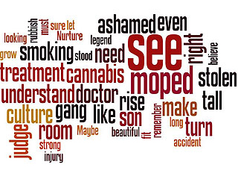
Assumptions
https://www.patientvoices.org.uk/flv/1172pv384.htm

Slide 16
Believe in me
https://www.patientvoices.org.uk/flv/1171pv384.htm

Slide 17
A future with autism?
https://www.patientvoices.org.uk/flv/1169pv384.htm

Slide 18
Winifred’s Journey
http://www.patientvoices.org.uk/flv/1200pv384.htm

Slide 19
Label love
http://www.patientvoices.org.uk/flv/1199pv384s.htm

Slide 20
Why?
http://www.patientvoices.org.uk/flv/1205pv384s.htm

Slide 21
Where are you from?
http://www.patientvoices.org.uk/flv/1202pv384s.htm

Slide 22
Miss Opportunity
http://www.patientvoices.org.uk/flv/1201pv384s.htm

Slide 23
Litter or legacy?
http://www.patientvoices.org.uk/flv/1204pv384s.htm

Slide 24
Entertain and educate, persuade and inspire
http://www.patientvoices.org.uk/flv/1203pv384s.htm

Slide 25
Questions for reflection
How do the stories illustrate the impact of equality and diversity in relation to situations inside and outside of work?
What actions are illustrated in the stories in relation to challenges faced by people from different background working for the NHS?
How might these stories promote equality and diversity?

Slide 26
Questions for reflection
How do these stories/this story connect with your own values or the things that really matter to you?
How might these stories encourage leaders to seize equality initiatives in the workplace?
How do the stories focus attention on the difference that diversity in the workplace can make?

Slide 27
Questions for reflection
What three things do these stories focus our attention on, in terms of what we should do next?
Having seen “Assumptions”, what is the one thing you feel compelled to do immediately?
Having seen “believe in me” and “not just pushing a wheelchair” what reasonable adjustments would you make to meet the needs of the employee and their carer
Having seen “Label love” what is your understanding of intersectionality and the impact of being a minority within a minority. What would you do next if you were in Gilly’s shoes?

Slide 28
Questions for reflection
Having seen “Entertain and educate, persuade and inspire” how can personal stories be used to promote diversity and inclusion in the NHS?
Having seen “Miss Opportunity” what can the NHS do to promote career opportunities for young people from BME backgrounds?
Having seen “Where are you from” what is the impact of exploring similarities where there are perceived differences for people from BME backgrounds?

